Slide 1
Municipal Law and the Attorneys Who Practice It
North Carolina Association of Municipal Attorney’s Recruitment and Engagement Committee

Slide 2
Outline
Municipalities
The Role of a Municipal Attorney
Benefits of Municipal Law Career
Getting Involved
Questions

Slide 3
Municipalities
A municipality is a single administrative division having corporate status and powers of self-government or jurisdiction as granted by national or regional laws to which it is subordinate for the better government of the people within its jurisdiction.
Notes:
Photos pulled from google.

Slide 4
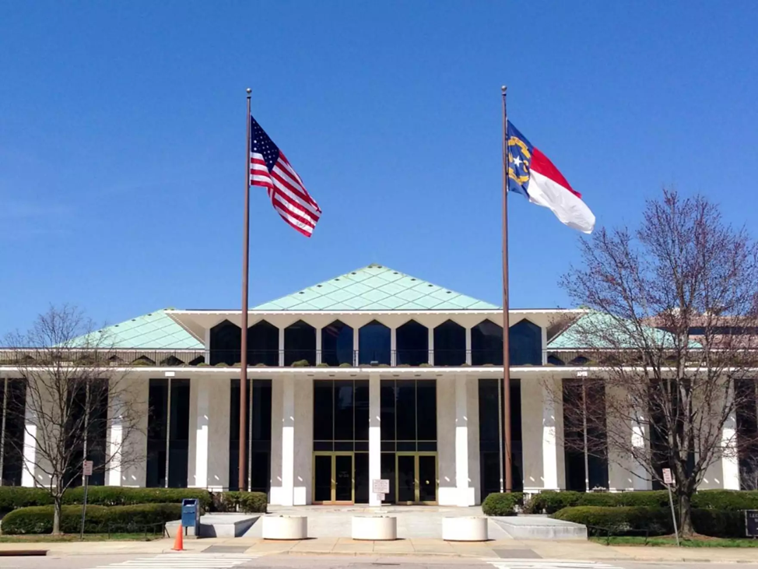
North Carolina municipalities have authority granted to them by the North Carolina General Assembly through the general statutes, local acts, or charter provisions.
There are 552 Municipalities across 100 North Carolina counties.
Notes:
Photo pulled from google

Slide 5
The North Carolina General Statutes govern North Carolina municipalities such as:
Chapter 132: public records
Chapter 143: open meetings & bidding requirements
Chapter 160A: municipal powers
Chapter 160D: zoning, planning, & development
Notes:
Photo pulled from google

Slide 6
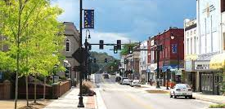
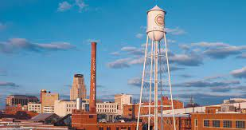
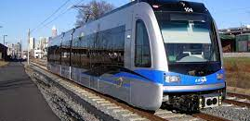
Municipalities perform these functions:
Legislating & Policymaking
Parks and Recreation
Emergency Services (Police & Fire)
Streets and Sidewalk
Public Transportation (Bus & Train)
Water and Sewer Systems
Land use (zoning, development & historic preservation)
Notes:
Photos pulled from google

Slide 7
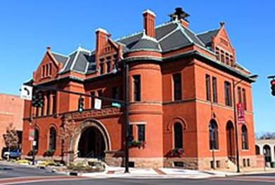
Municipalities appoint individuals to provide advice or perform tasks such as:
Planning Commissions
Housing Appeals Boards
Human Relations Commissions
UDO Board of Adjustments
Recreation Advisory Commissions
Notes:
Photo pulled from google

Slide 8
The Role of a Municipal Attorney
Municipal law is an area of law considered public interest. Municipal attorneys provide direct support to local governments in all aspects of their functions.

Slide 9
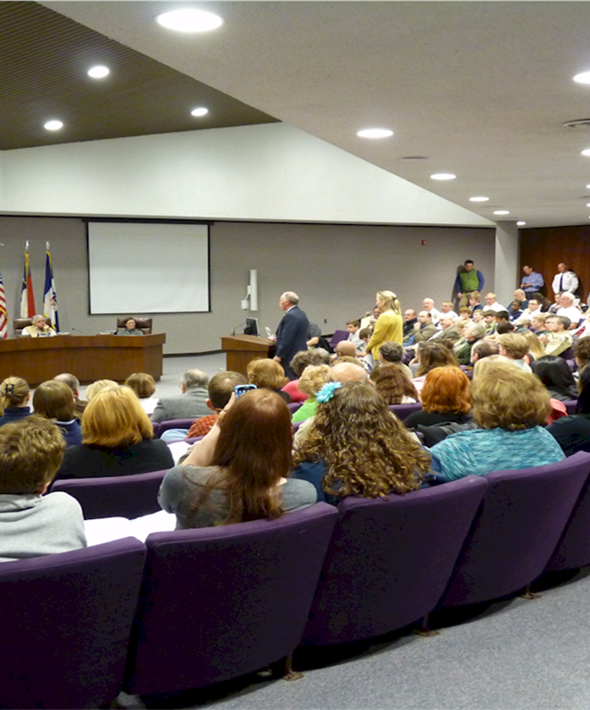
While there are differences between Municipal Attorneys and other government attorneys, the most notable being that Municipal attorneys have a direct impact on the community in which their municipality serves.
Notes:
Photo pulled from google

Slide 10
The municipal attorney represents the municipality and perform the following actions:
Providing legal advice to elected officials and municipal staff.
Conducting Real Estate Transactions.
Drafting contracts for economic development, construction, services, and goods.
Engaging in litigation.
Notes:
Photo pulled from google

Slide 11
Benefits of Working in Municipal Law
Wide variety of practice areas
Tangible and visible effect on the community
Work-Life Balance & Competitive Benefits
Collaboration with colleagues at the North Carolina Association of Municipal Attorneys and the International Municipal Lawyers’ Association

Slide 12
Getting Involved
Do Internships, Externships, and Job-shadowing.
Contact your municipality’s attorney or any elected official.
Go to the North Carolina Association of Municipal Attorneys’ website:
Attend annual North Carolina Association of Municipal Attorneys’ conference in Chapel Hill.

Slide 13
QUESTIONS?

