Slide 1
Municipal Law and the Attorneys Who Practice
North Carolina Association of Municipal Attorney’s Recruitment and Engagement Committee

Slide 2
Outline
Who are we?
What is a municipality and its functions
The Role of a Municipal Attorney
Benefits of Working in Municipal Law
How to Learn More about and get involved in Municipal Law?
Questions

Slide 3
North Carolina Municipal Attorney’s Association
The North Carolina Association of Municipal Attorneys is the attorney member association of the NC League of Municipalities which is an organization that provides support to Municipalities across the State of North Carolina.
​The North Carolina League of Municipalities is a member-driven organization representing the interests of cities and towns in the state. Through their collective efforts, League member cities and towns better serve their residents and improve quality of life.
For more than 100 years, the League has been one voice for cities and towns working for a better North Carolina.​
Notes:
I pulled the last two bullets from the NCLM website.

Slide 4
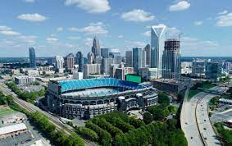
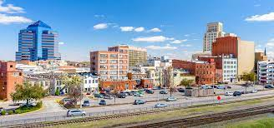
What is a municipality?
A municipality is usually a single administrative division having corporate status and powers of self-government or jurisdiction as granted by national or regional laws to which it is subordinate for the better government of the people within its jurisdiction.
Municipalities include Cities, Towns , and Villages
Notes:
Photos pulled from google.

Slide 5
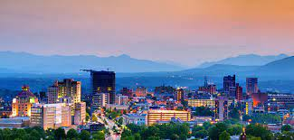
Municipalities in North Carolina
There are 552 Municipalities across 100 Counties in North Carolina
Dillion’s Rule: Municipalities in NC can generally only function within the authority that it is granted by the North Carolina General Assembly within its charter, general statutes, or local acts.
Municipalities in North Carolina are governed primarily by two main chapters of the North Carolina General Statutes Chapters 160A and 160D among others.
Municipalities are further governed by judicial interpretations.
Notes:
Photo pulled from google

Slide 6
Municipalities Interaction with the Community
Municipalities serve the community and have the role to protect the general welfare of that community.
The community is involved in the the functions of municipalities through the election of the governing body and participation on volunteer boards. Volunteer boards include:
Planning and Zoning Commissions
Human Relations Commissions
Housing Appeals Boards
Recreation Advisory Commissions
A municipalities provide services to the community and many of its roles are outward facing to facilitate that service through various municipal functions.

Slide 7
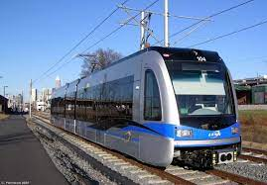
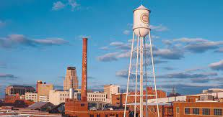
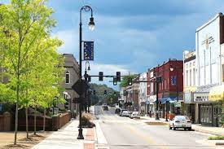
Functions of a Municipality
Municipalities have many functions such as:
Governing Body (Political Body Elected by the Community)
Water and Sewer Systems
Public Transportation (Light rails and Busses)
Emergency Response (Police and Fire departments)
Streets and Sidewalk
Land use (zoning, historic preservation)
Parks and Recreation (Maintain park facilities and community programming)
Notes:
Photos pulled from google

Slide 8
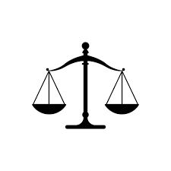
Municipal Attorneys in Public Interest
Municipal law is an area of law considered public interest. There are many types of public interest attorneys to include:
District Attorneys
Public Defenders
Legal Aid
Federal Agency Attorneys
State Agency Attorneys
Municipal Attorneys provide direct support to local governments in all aspects of their functions. Municipal attorneys are often referred to as generalist and handle any matters that are related to their municipality.
While there are differences between Municipal Attorneys and other government attorneys, the most notable being that Municipal attorneys have a direct impact on the community in which their municipality serves.

Slide 9
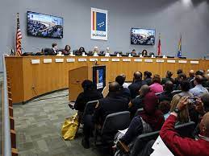
The Role of Municipal Attorneys
While each municipality in North Carolina does not have an in house attorney many do or contract out for attorney services.
The City, Town or Village attorney represents the municipality in various areas to include:
Providing advice to elected governing body (City or Town Council)
Advising Various departments within the municipality
Transactions such as contracts (Construction, Services, Purchases)
Economic and Community Development
Real Estate Transactions
Litigation
Notes:
Photo pulled from google

Slide 10
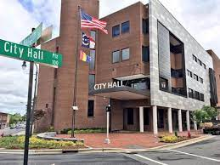
Municipal Practices Areas
Municipal Attorneys even those who are contracted function very similarly to in house council for a corporation
Practice Areas include:
Human Resources
Commercial Lending
Transactions
Construction
Land Use (Zoning)
Real Estate
Litigation
Administrative Law
Constitutional Law
Notes:
Photo pulled from google

Slide 11
Benefits of Working in Municipal Law
While there are many benefits to working in municipal law some notable benefits:
Wide variety of practice areas
Network of Attorneys
Tangible and visible effect on the community that is being served
Collaboration across municipalities
Work Life Balance
Competitive Benefits
Longevity in Role
Notes:
Photo pulled from google

Slide 12
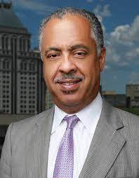
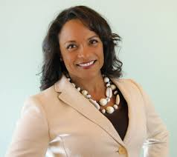
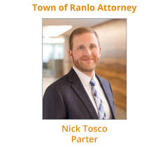
Current NC Municipal Attorneys
Meredith Everhart, City of Wilmington
Patrick Baker,
City of Charlotte
Chuck Watts,
City of Greensboro
Brad Branham,
City of Asheville
Poyner Spruill
Kim Rehberg,
City of Durham
Notes:
Photos pulled from google

Slide 13
How to learn more about and get involved Municipal Law?
While Municipal Law has been around for 100s of years many are not aware of this area of law but the Recruitment and Engagement Committee of the NCAMA is hoping to change that narrative.
You can get involved and learn more about municipal law through:
Internships
Externships
Shadowing
Contacting your local City/Town/Village Attorneys Office
Attending Bar Association Meetings
Contacting the NCMAA or NCLM
Attend Informational Programs

Slide 14
QUESTIONS?

